Slide 1

Formation of transient spiral arms and galaxy rotation curves
Francesco Sylos Labini
Institute for Complex Systems, CNR (Rome, Italy)
Enrico Fermi Center (Rome, Italy)

Slide 2
Outline
Long Range Interacting and Self Gravitating Systems
Collapse of an isolated self-gravitating cloud
Formation of a disk and transient arms/bar/rings
Astrophysical considerations
Cosmological considerations
Notes:
v_{200}= \frac{a_3/\tau_d}{200} \;
\mbox{km/sec}
n \approx 50
t_{\rm Gyr} \sim 1
M = \frac{\pi^2 a_3^3}{8 G \tau_d} \approx 10^{11} M_{\odot}
R_1 \approx 2 \;\; \mbox{kpc}
a_3 \approx \left( \frac{200 \, v_{200}}{n}
\times t_{\rm Gyr}\right) \,{\rm kpc}
\[\vec{v}_t = \frac{\vec{r} \times
\vec{v}}{{r}}\;,
\beta (r) = 1 - \frac{\langle v_t^2 \rangle}{2 \langle v_r^2 \rangle}

Slide 3
Outline
Long Range Interacting and Self Gravitating Systems
Collapse of an isolated self-gravitating cloud
Formation of a disk and transient arms/bar/rings
Astrophysical considerations
Cosmological considerations
Notes:
v_{200}= \frac{a_3/\tau_d}{200} \;
\mbox{km/sec}
n \approx 50
t_{\rm Gyr} \sim 1
M = \frac{\pi^2 a_3^3}{8 G \tau_d} \approx 10^{11} M_{\odot}
R_1 \approx 2 \;\; \mbox{kpc}
a_3 \approx \left( \frac{200 \, v_{200}}{n}
\times t_{\rm Gyr}\right) \,{\rm kpc}
\[\vec{v}_t = \frac{\vec{r} \times
\vec{v}}{{r}}\;,
\beta (r) = 1 - \frac{\langle v_t^2 \rangle}{2 \langle v_r^2 \rangle}

Slide 4
Long Range Interacting Systems
Notes:
\frac{d^2 \vec{r}_i} { dt^2} = -Gm \sum_{j\ne i}^{j=1,N} \frac{\vec{r}_i-\vec{r}_j}{|\vec{r}_i-\vec{r}_j|^3}

Slide 5
Long Range Interacting Systems
SRIS:
Notes:
\frac{d^2 \vec{r}_i} { dt^2} = -Gm \sum_{j\ne i}^{j=1,N} \frac{\vec{r}_i-\vec{r}_j}{|\vec{r}_i-\vec{r}_j|^3}

Slide 6
Long Range Interacting Systems
SRIS:
LRIS:
Notes:
\frac{d^2 \vec{r}_i} { dt^2} = -Gm \sum_{j\ne i}^{j=1,N} \frac{\vec{r}_i-\vec{r}_j}{|\vec{r}_i-\vec{r}_j|^3}

Slide 7
Long Range Interacting Systems
SRIS: equilibrium, thermodynamical properties from microscopic interactions (ensemble equivalence).
Notes:
\frac{d^2 \vec{r}_i} { dt^2} = -Gm \sum_{j\ne i}^{j=1,N} \frac{\vec{r}_i-\vec{r}_j}{|\vec{r}_i-\vec{r}_j|^3}

Slide 8
Long Range Interacting Systems
SRIS: equilibrium, thermodynamical properties from microscopic interactions (ensemble equivalence).
SRIS: an out of equilibrium state is driven by local interactions towards a TDE state characterized by the maximum value of the entropy compatible with the conditions imposed
Notes:
\frac{d^2 \vec{r}_i} { dt^2} = -Gm \sum_{j\ne i}^{j=1,N} \frac{\vec{r}_i-\vec{r}_j}{|\vec{r}_i-\vec{r}_j|^3}

Slide 9
Long Range Interacting Systems
SRIS: equilibrium, thermodynamical properties from microscopic interactions (ensemble equivalence).
SRIS: an out of equilibrium state is driven by local interactions towards a TDE state characterized by the maximum value of the entropy compatible with the conditions imposed
LRIS: energy not additive→ Virial theorem, negative specific heat
Notes:
\frac{d^2 \vec{r}_i} { dt^2} = -Gm \sum_{j\ne i}^{j=1,N} \frac{\vec{r}_i-\vec{r}_j}{|\vec{r}_i-\vec{r}_j|^3}

Slide 10
Long Range Interacting Systems
SRIS: equilibrium, thermodynamical properties from microscopic interactions (ensemble equivalence).
SRIS: an out of equilibrium state is driven by local interactions towards a TDE state characterized by the maximum value of the entropy compatible with the conditions imposed
LRIS: energy not additive→ Virial theorem, negative specific heat
LRIS long-lived dynamical states not in TDE → QSS
Notes:
\frac{d^2 \vec{r}_i} { dt^2} = -Gm \sum_{j\ne i}^{j=1,N} \frac{\vec{r}_i-\vec{r}_j}{|\vec{r}_i-\vec{r}_j|^3}

Slide 11
Long Range Interacting Systems
SRIS: equilibrium, thermodynamical properties from microscopic interactions (ensemble equivalence).
SRIS: an out of equilibrium state is driven by local interactions towards a TDE state characterized by the maximum value of the entropy compatible with the conditions imposed
LRIS: energy not additive→ Virial theorem, negative specific heat
LRIS long-lived dynamical states not in TDE → QSS
LRIS: very different time scales in the relaxation process
Notes:
\frac{d^2 \vec{r}_i} { dt^2} = -Gm \sum_{j\ne i}^{j=1,N} \frac{\vec{r}_i-\vec{r}_j}{|\vec{r}_i-\vec{r}_j|^3}

Slide 12
Self Gravitating systems
IC: out of equilibrium system
Notes:
\nabla^2 \Phi(\vec{x}) = {4 \pi G} m \int f(\vec{x},\vec{v},t) d\vec{v}
\partial_t f + \vec{v} \cdot \nabla_{\vec{x}} f + \frac{1}{m} \vec{F} \cdot \nabla_{\vec{v}} f = 0
\frac{1}{2} \langle \ddot{I} \rangle = 2 \langle K \rangle + \langle W \rangle = 0

Slide 13
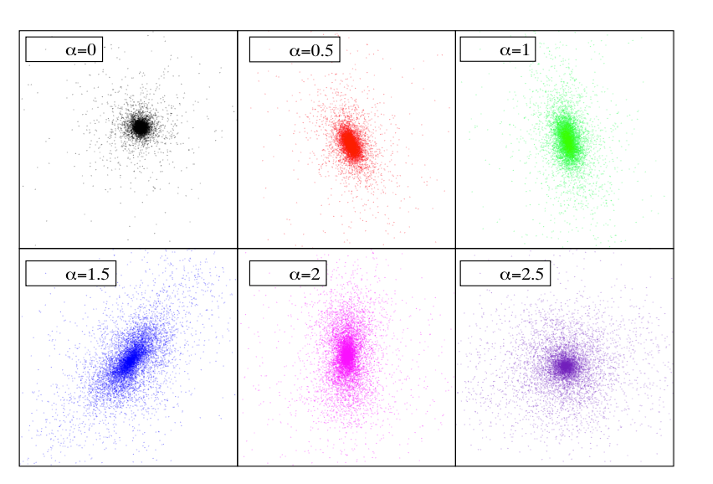
Self Gravitating systems
IC: out of equilibrium system
Violent relaxation: global collapse, mean-field dynamics, collisionless physics
Quasi stationary state (virial equilibrium)
Notes:
\nabla^2 \Phi(\vec{x}) = {4 \pi G} m \int f(\vec{x},\vec{v},t) d\vec{v}
\partial_t f + \vec{v} \cdot \nabla_{\vec{x}} f + \frac{1}{m} \vec{F} \cdot \nabla_{\vec{v}} f = 0
\frac{1}{2} \langle \ddot{I} \rangle = 2 \langle K \rangle + \langle W \rangle = 0

Slide 14
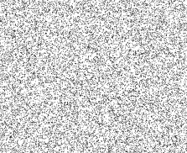
Self Gravitating systems
IC: out of equilibrium system
Violent relaxation: global collapse, mean-field dynamics, collisionless physics
Collisional relaxation (>> T_{H})
Quasi stationary state (virial equilibrium)
Notes:
\nabla^2 \Phi(\vec{x}) = {4 \pi G} m \int f(\vec{x},\vec{v},t) d\vec{v}
\partial_t f + \vec{v} \cdot \nabla_{\vec{x}} f + \frac{1}{m} \vec{F} \cdot \nabla_{\vec{v}} f = 0
\frac{1}{2} \langle \ddot{I} \rangle = 2 \langle K \rangle + \langle W \rangle = 0

Slide 15
Long Range Interacting Systems
If the system is isolated and confined in space and momentum:
Notes:
\frac{d^2 \vec{r}_i} { dt^2} = -Gm \sum_{j\ne i}^{j=1,N} \frac{\vec{r}_i-\vec{r}_j}{|\vec{r}_i-\vec{r}_j|^3}

Slide 16
Self Gravitating systems
Collisionless Boltzmann equation
Poisson equation
Notes:
\nabla^2 \Phi(\vec{x}) = {4 \pi G} m \int f(\vec{x},\vec{v},t) d\vec{v}
\partial_t f + \vec{v} \cdot \nabla_{\vec{x}} f + \frac{1}{m} \vec{F} \cdot \nabla_{\vec{v}} f = 0
\frac{1}{2} \langle \ddot{I} \rangle = 2 \langle K \rangle + \langle W \rangle = 0

Slide 17
Self Gravitating systems
+
Notes:
\nabla^2 \Phi(\vec{x}) = {4 \pi G} m \int f(\vec{x},\vec{v},t) d\vec{v}
\partial_t f + \vec{v} \cdot \nabla_{\vec{x}} f + \frac{1}{m} \vec{F} \cdot \nabla_{\vec{v}} f = 0
\frac{1}{2} \langle \ddot{I} \rangle = 2 \langle K \rangle + \langle W \rangle = 0

Slide 18
Self Gravitating systems
+
Stationary solutions of the VP’s equations
Notes:
\nabla^2 \Phi(\vec{x}) = {4 \pi G} m \int f(\vec{x},\vec{v},t) d\vec{v}
\partial_t f + \vec{v} \cdot \nabla_{\vec{x}} f + \frac{1}{m} \vec{F} \cdot \nabla_{\vec{v}} f = 0
\frac{1}{2} \langle \ddot{I} \rangle = 2 \langle K \rangle + \langle W \rangle = 0

Slide 19
Self Gravitating systems
IC: out of equilibrium system
Notes:
\nabla^2 \Phi(\vec{x}) = {4 \pi G} m \int f(\vec{x},\vec{v},t) d\vec{v}
\partial_t f + \vec{v} \cdot \nabla_{\vec{x}} f + \frac{1}{m} \vec{F} \cdot \nabla_{\vec{v}} f = 0
\frac{1}{2} \langle \ddot{I} \rangle = 2 \langle K \rangle + \langle W \rangle = 0

Slide 20
Self Gravitating systems
IC: out of equilibrium system
Violent relaxation: global collapse, mean-field dynamics, collisionless physics
Quasi stationary state (virial equilibrium)
Notes:
\nabla^2 \Phi(\vec{x}) = {4 \pi G} m \int f(\vec{x},\vec{v},t) d\vec{v}
\partial_t f + \vec{v} \cdot \nabla_{\vec{x}} f + \frac{1}{m} \vec{F} \cdot \nabla_{\vec{v}} f = 0
\frac{1}{2} \langle \ddot{I} \rangle = 2 \langle K \rangle + \langle W \rangle = 0

Slide 21
Self Gravitating systems
Questions
Is collisionless relaxation really so fast ?
Does the whole system relax at the same time?
Is there anything else going on?
IC: out of equilibrium system
Violent relaxation: global collapse, mean-field dynamics, collisionless physics
Quasi stationary state (virial equilibrium)
Notes:
\nabla^2 \Phi(\vec{x}) = {4 \pi G} m \int f(\vec{x},\vec{v},t) d\vec{v}
\partial_t f + \vec{v} \cdot \nabla_{\vec{x}} f + \frac{1}{m} \vec{F} \cdot \nabla_{\vec{v}} f = 0
\frac{1}{2} \langle \ddot{I} \rangle = 2 \langle K \rangle + \langle W \rangle = 0

Slide 22
Outline
Long Range Interacting and Self Gravitating Systems
Collapse of an isolated self-gravitating cloud
Formation of a disk and transient arms/bar/rings
Astrophysical considerations
Cosmological considerations
Notes:
v_{200}= \frac{a_3/\tau_d}{200} \;
\mbox{km/sec}
n \approx 50
t_{\rm Gyr} \sim 1
M = \frac{\pi^2 a_3^3}{8 G \tau_d} \approx 10^{11} M_{\odot}
R_1 \approx 2 \;\; \mbox{kpc}
a_3 \approx \left( \frac{200 \, v_{200}}{n}
\times t_{\rm Gyr}\right) \,{\rm kpc}
\[\vec{v}_t = \frac{\vec{r} \times
\vec{v}}{{r}}\;,
\beta (r) = 1 - \frac{\langle v_t^2 \rangle}{2 \langle v_r^2 \rangle}

Slide 23
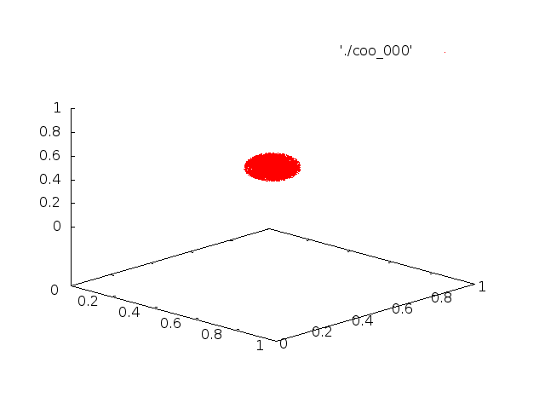
Dynamics of a spherical isolated, uniform cold cloud
Joyce M., Marcos B., Sylos Labini F., MNRAS, 397, 2, 775-792 (2009) Sylos Labini, F. 2013, Astron.Astrophys, 552A, 36
Notes:
\frac{d^2 \vec{r}_i} { dt^2} = -Gm \sum_{j\ne i}^{j=1,N} \frac{\vec{r}_i-\vec{r}_j}{|\vec{r}_i-\vec{r}_j|^3}

Slide 24
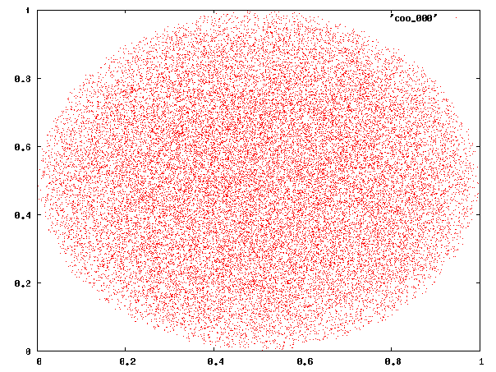


Slide 25

Particles motion in a rapidly varying gravitational field

Slide 26
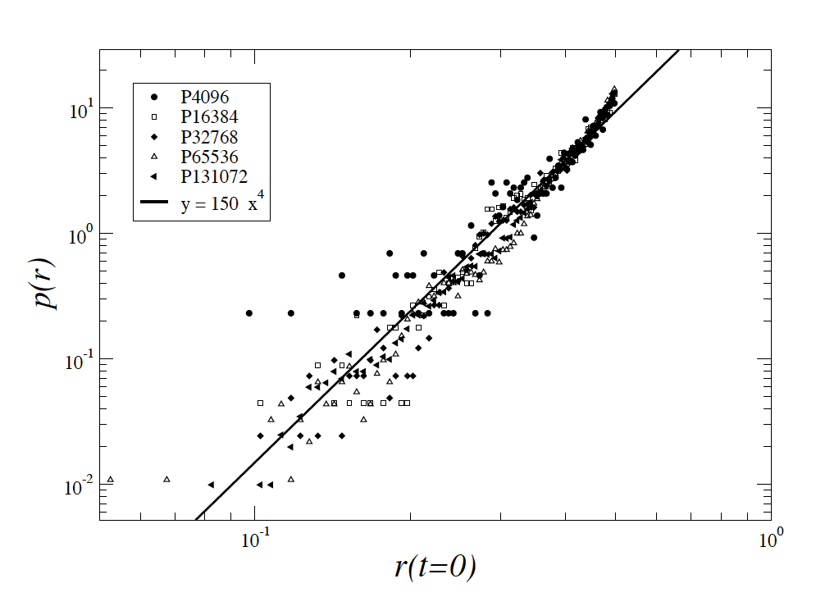
Probability of being ejected

Slide 27
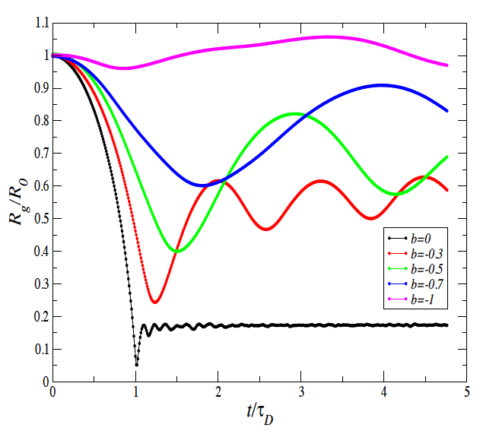
From cold to warm clouds
Warmer IC
contraction
Sylos Labini, F, Mon.Not.R.Acad.Soc, 429, 679, 2013

Slide 28
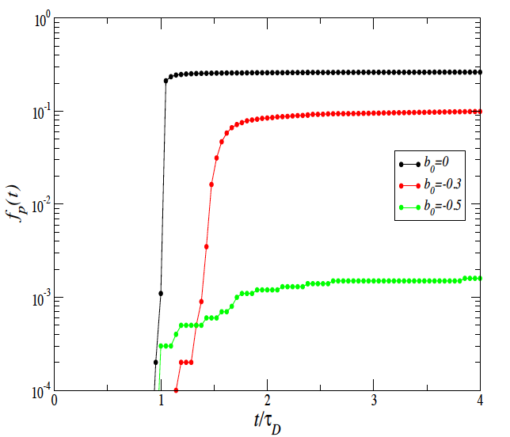
From cold to warm clouds
Warmer IC
Warmer IC
contraction
Sylos Labini, F, Mon.Not.R.Acad.Soc, 429, 679, 2013

Slide 29
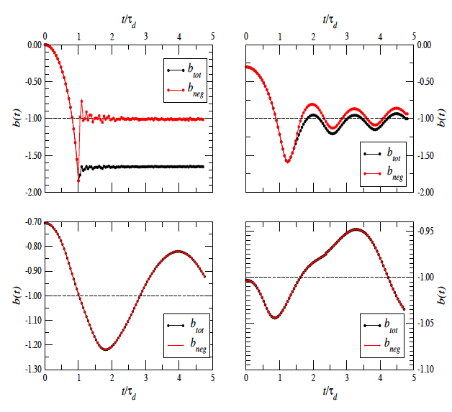
From cold to warm clouds
Sylos Labini, F, 2012, Mon.Not.R.Acad.Soc., 423, 1610S

Slide 30
Collapse of non-uniform, isolated spherical clouds
Benhaiem D. Joyce M., Sylos Labini F., Worrakiponpon, T. A&A, 585, A139, 2016

Slide 31
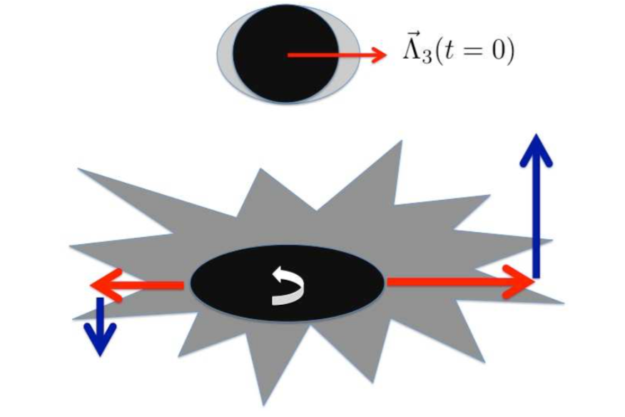
Generation of Angular Momentum
Benhaiem D. Joyce M., Sylos Labini F., Worrakiponpon, T. A&A, 585, A139, 2016

Slide 32
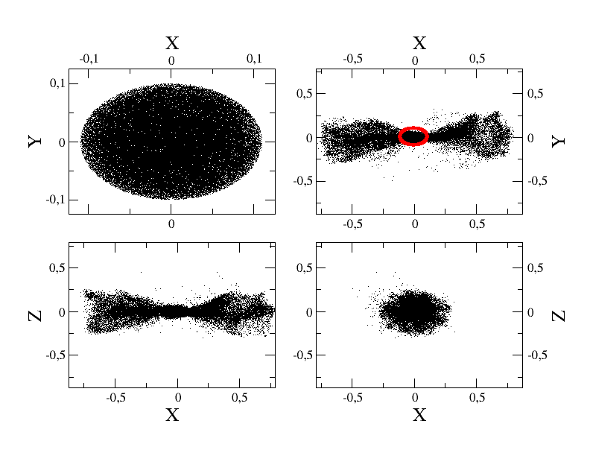
Collapse of an ellipsoidal isolated cloud
Y
Benhaiem & Sylos Labini Mon.Not.R. Astron. Soc 448, 2634-2643 (2015)

Slide 33
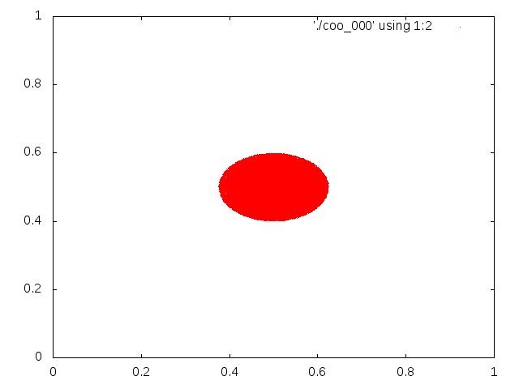


Slide 34
Particles motion in a rapidly varying gravitational field

Slide 35
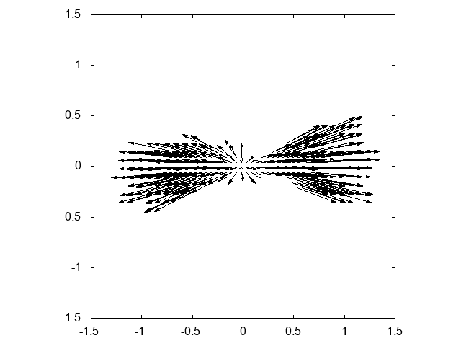
Collapse of an ellipsoidal isolated cloud

Slide 36
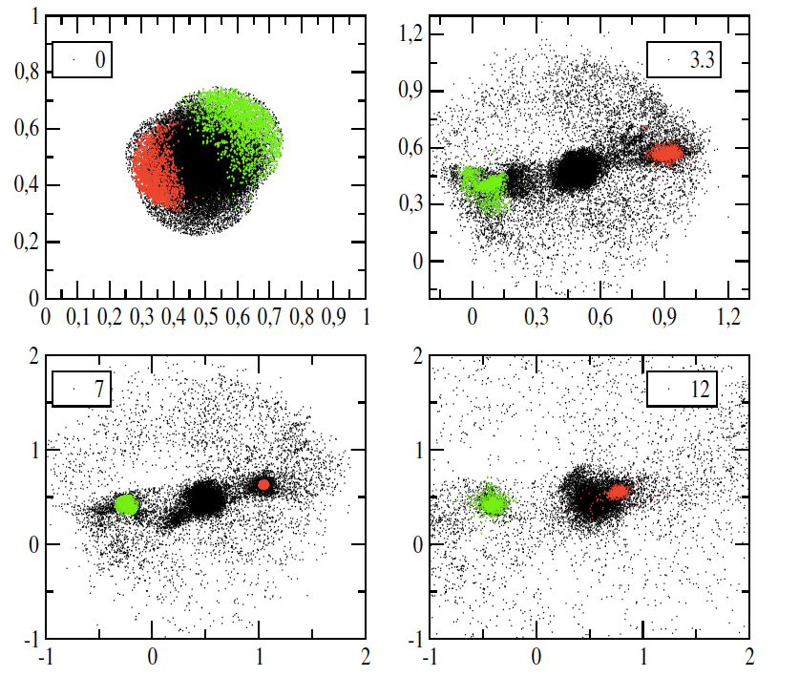
Collapse of irregular inhomogeneous clouds
Benhaiem & Sylos Labini, Astron.Astrophys. 598, A95 (2017)

Slide 37
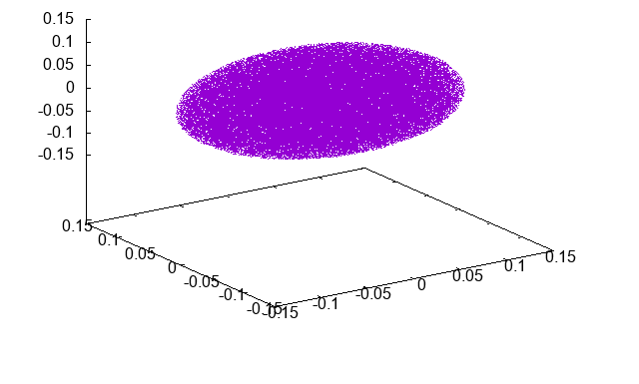
Collapse of rotating ellipsoidal clouds
Z
Y
X
D. Benhaiem, M. Joyce, F. Sylos Labini, Astrophysical Journal, 851, 19 (2017)
Notes:
\vec{v} = \vec{\Omega} \times \vec{r} ; \vec{\Omega} = [0,0,\Omega] ; \tau_d = \sqrt{ \frac{\pi^2 a_3^3}{8 G M}}

Slide 38
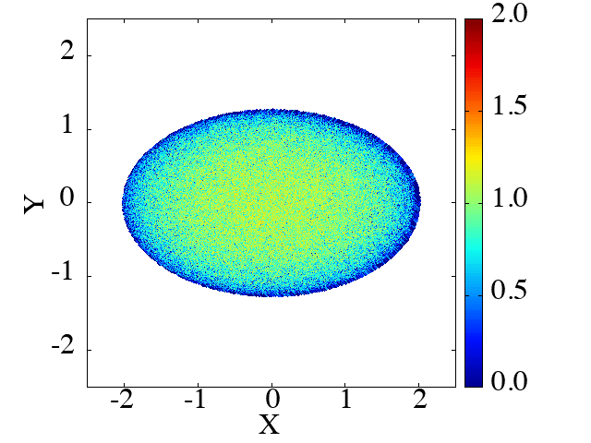


Slide 39
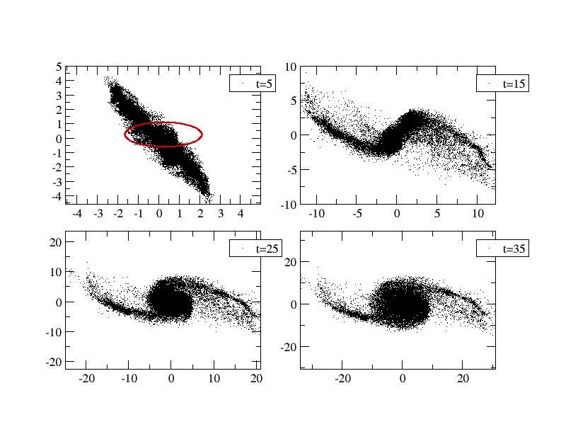
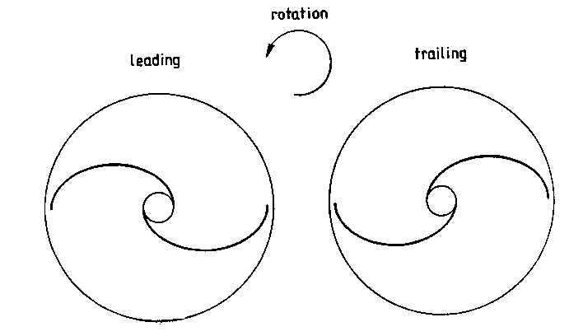

Slide 40
Long return times (long lived transients)
Notes:
The finite lifetime of these configurations arise from the fact that they are formed of particles with energy close to, or slightly larger than, zero that move, after the collapse, in a gravitational potential which, to a crude approximation, is spherically symmetric and stationary so that they conserve their energy and the angular momentum \cite{bjslmnars2017}. In particular, the formation of the sprial arms is related to the approximate conservation of angular momentum as particles radial displacement will be correlated with a decrease of their angular velocity relative to the centre of the structure; in this way the particles which go furthestwill ``wind up" less and a spiral type structure can result.

Slide 41
Long return times
Spherically symmetric potential
Notes:
The finite lifetime of these configurations arise from the fact that they are formed of particles with energy close to, or slightly larger than, zero that move, after the collapse, in a gravitational potential which, to a crude approximation, is spherically symmetric and stationary so that they conserve their energy and the angular momentum \cite{bjslmnars2017}. In particular, the formation of the sprial arms is related to the approximate conservation of angular momentum as particles radial displacement will be correlated with a decrease of their angular velocity relative to the centre of the structure; in this way the particles which go furthestwill ``wind up" less and a spiral type structure can result.

Slide 42
Long return times
Spherically symmetric potential
Energy conservation
Angular momentum conservation
Notes:
The finite lifetime of these configurations arise from the fact that they are formed of particles with energy close to, or slightly larger than, zero that move, after the collapse, in a gravitational potential which, to a crude approximation, is spherically symmetric and stationary so that they conserve their energy and the angular momentum \cite{bjslmnars2017}. In particular, the formation of the sprial arms is related to the approximate conservation of angular momentum as particles radial displacement will be correlated with a decrease of their angular velocity relative to the centre of the structure; in this way the particles which go furthestwill ``wind up" less and a spiral type structure can result.

Slide 43
Angular momentum conservation
Notes:
The finite lifetime of these configurations arise from the fact that they are formed of particles with energy close to, or slightly larger than, zero that move, after the collapse, in a gravitational potential which, to a crude approximation, is spherically symmetric and stationary so that they conserve their energy and the angular momentum \cite{bjslmnars2017}. In particular, the formation of the sprial arms is related to the approximate conservation of angular momentum as particles radial displacement will be correlated with a decrease of their angular velocity relative to the centre of the structure; in this way the particles which go furthestwill ``wind up" less and a spiral type structure can result.

Slide 44
Angular momentum conservation
Differential rotation
Notes:
The finite lifetime of these configurations arise from the fact that they are formed of particles with energy close to, or slightly larger than, zero that move, after the collapse, in a gravitational potential which, to a crude approximation, is spherically symmetric and stationary so that they conserve their energy and the angular momentum \cite{bjslmnars2017}. In particular, the formation of the sprial arms is related to the approximate conservation of angular momentum as particles radial displacement will be correlated with a decrease of their angular velocity relative to the centre of the structure; in this way the particles which go furthestwill ``wind up" less and a spiral type structure can result.

Slide 45
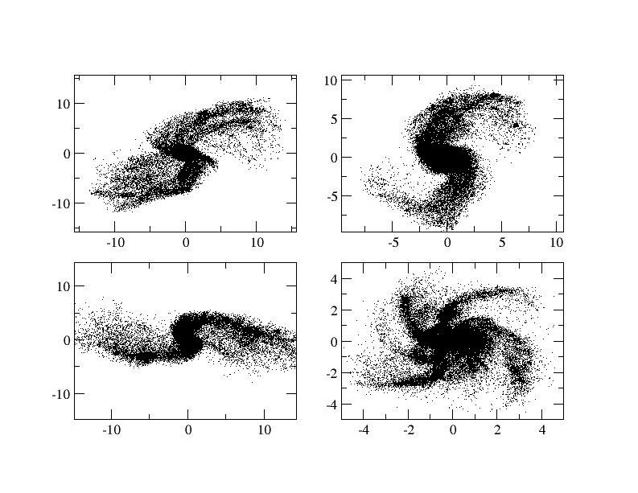

Slide 46
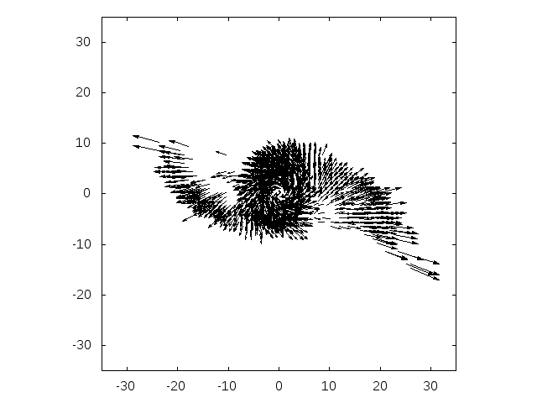

Slide 48
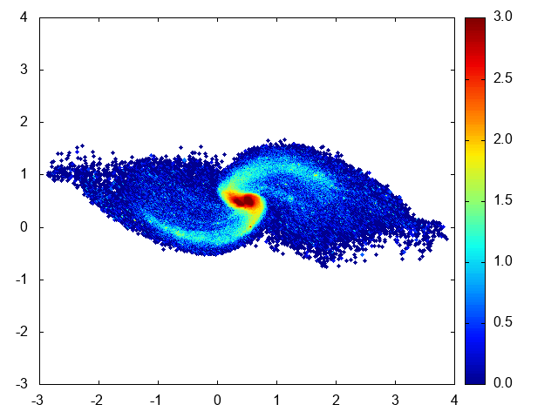
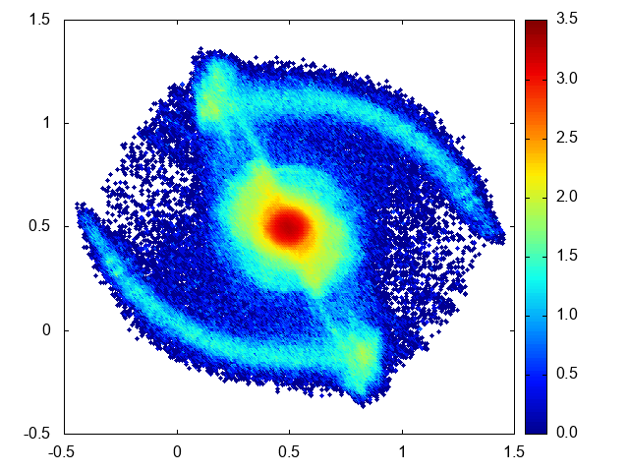
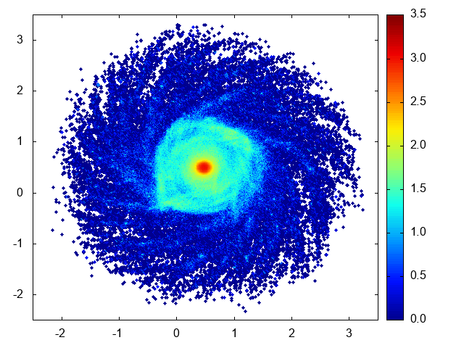
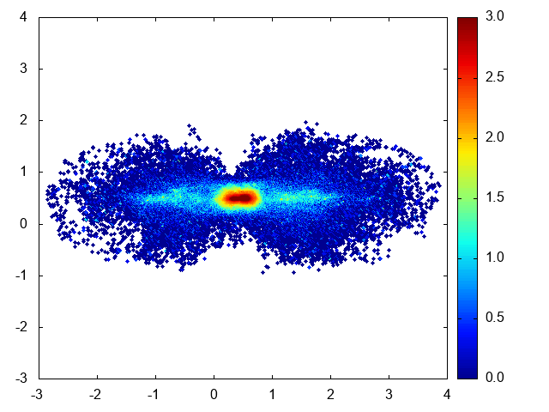
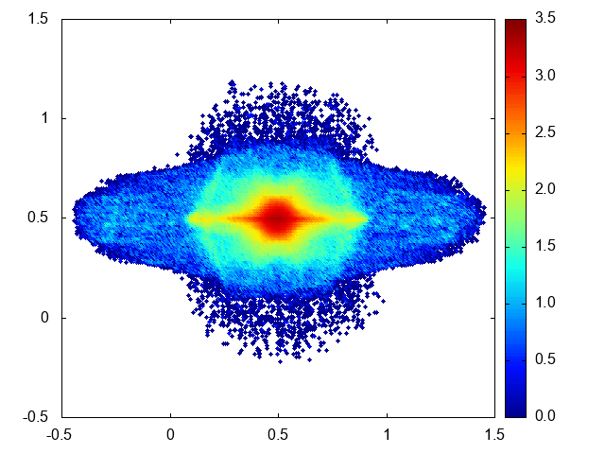
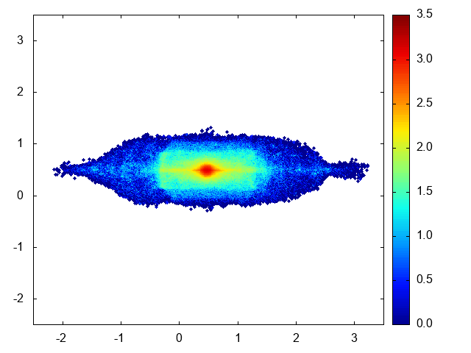

Slide 49
Two arms (mainly)
Trailing arms
No winding problem
Pitch angle some tens degrees

Slide 50
Notes:
n(r) \sim r^{-4}

Slide 52
Particles with energy close to (or larger than) zero and thus with very long return times

Slide 53
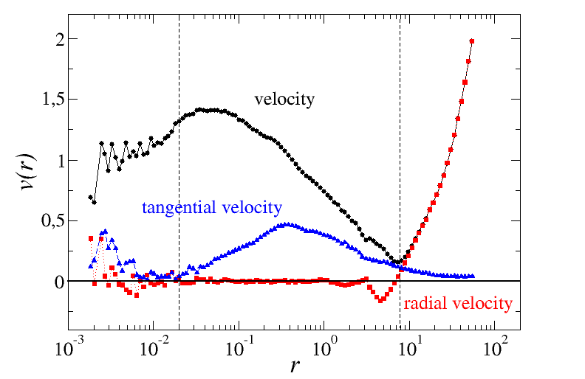
Notes:
{v}_r =\frac{\vec{r} \cdot \vec{v}}{{r}}
M_c= \frac{v^2 \cdot r}{G}
\langle |\vec{v}_t | \rangle \gg |\langle \vec{v}_t \rangle|
\langle |\vec{v}_t | \rangle \approx |\langle \vec{v}_t \rangle | \gg \langle |{v}_r| \rangle
\langle |\vec{v}| \rangle \approx \langle |{v}_r|
\rangle \approx |\langle {v}_r \rangle |
\[\vec{v}_t = \frac{\vec{r} \times
\vec{v}}{{r}}\;,
\beta (r) = 1 - \frac{\langle v_t^2 \rangle}{2 \langle v_r^2 \rangle}

Slide 54
Notes:
{v}_r =\frac{\vec{r} \cdot \vec{v}}{{r}}
M_c= \frac{v^2 \cdot r}{G}
\[\vec{v}_t = \frac{\vec{r} \times
\vec{v}}{{r}}\;,
\beta (r) = 1 - \frac{\langle v_t^2 \rangle}{2 \langle v_r^2 \rangle}

Slide 55
Notes:
{v}_r =\frac{\vec{r} \cdot \vec{v}}{{r}}
M_c= \frac{v^2 \cdot r}{G}
\[\vec{v}_t = \frac{\vec{r} \times
\vec{v}}{{r}}\;,
\beta (r) = 1 - \frac{\langle v_t^2 \rangle}{2 \langle v_r^2 \rangle}

Slide 56
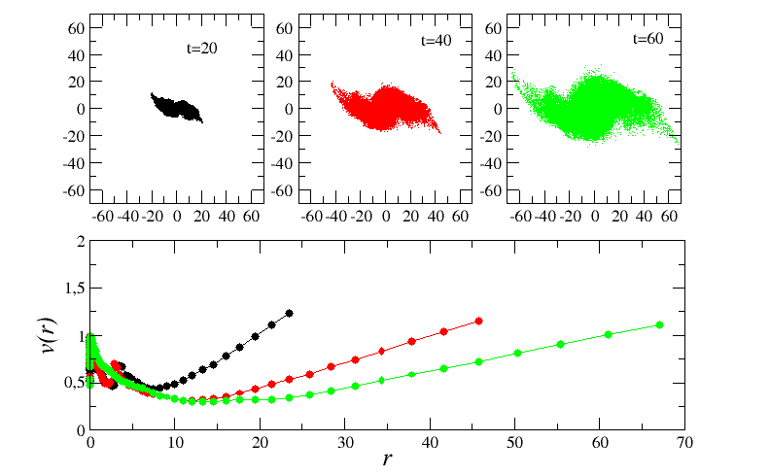
Notes:
{v}_r =\frac{\vec{r} \cdot \vec{v}}{{r}}
M_c= \frac{v^2 \cdot r}{G}
\[\vec{v}_t = \frac{\vec{r} \times
\vec{v}}{{r}}\;,
\beta (r) = 1 - \frac{\langle v_t^2 \rangle}{2 \langle v_r^2 \rangle}

Slide 57
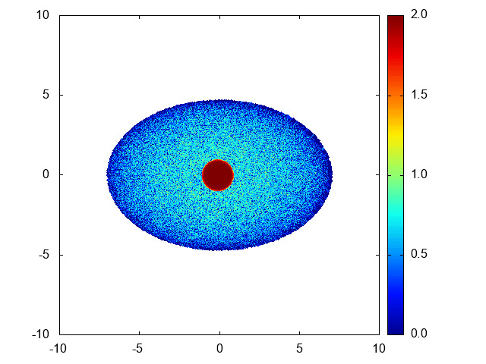
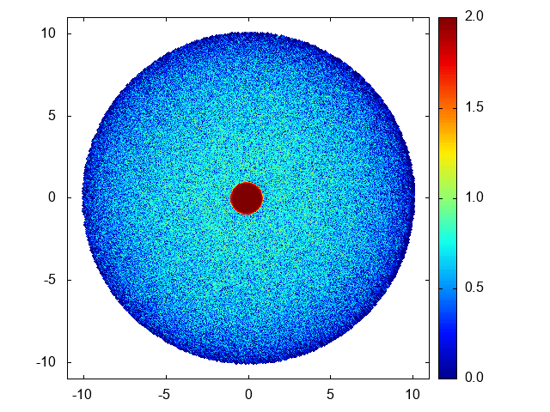
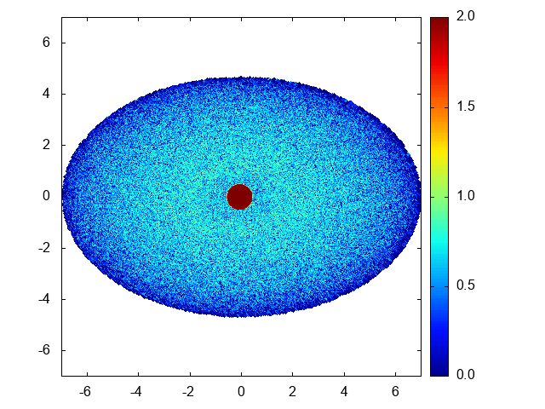
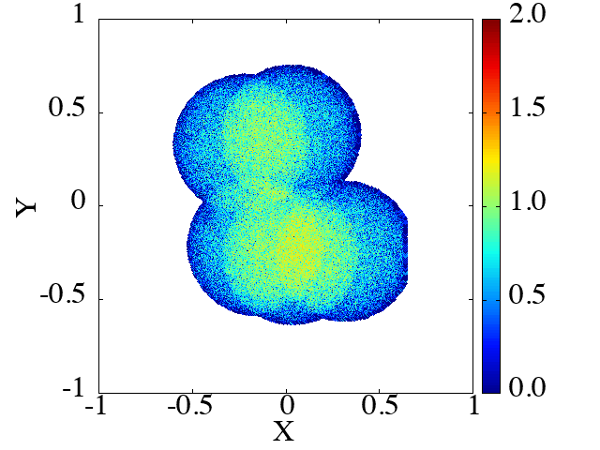





Slide 58
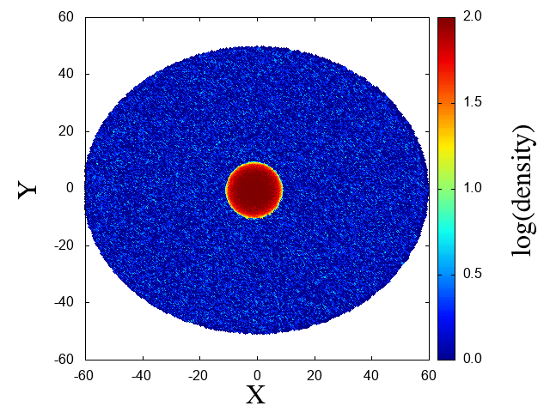
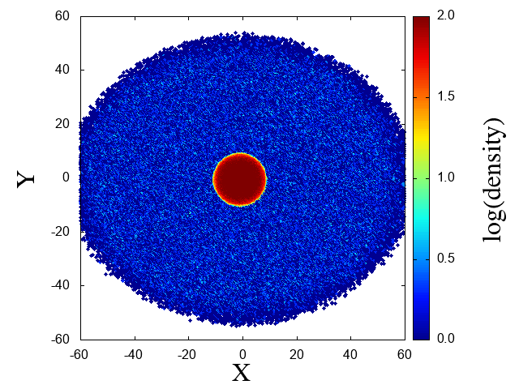
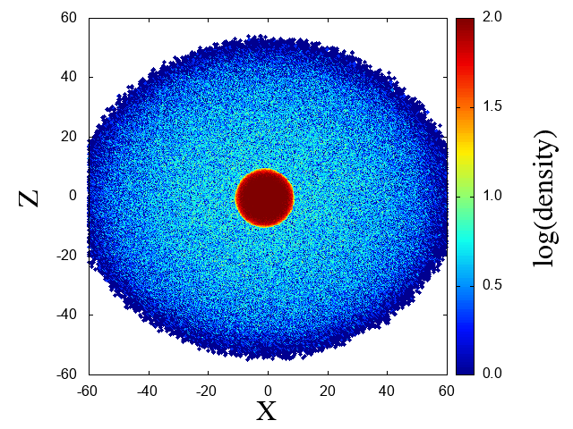
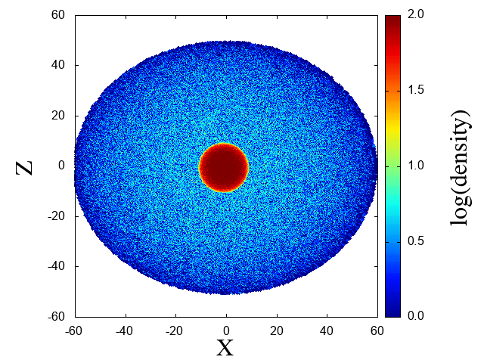

Slide 59
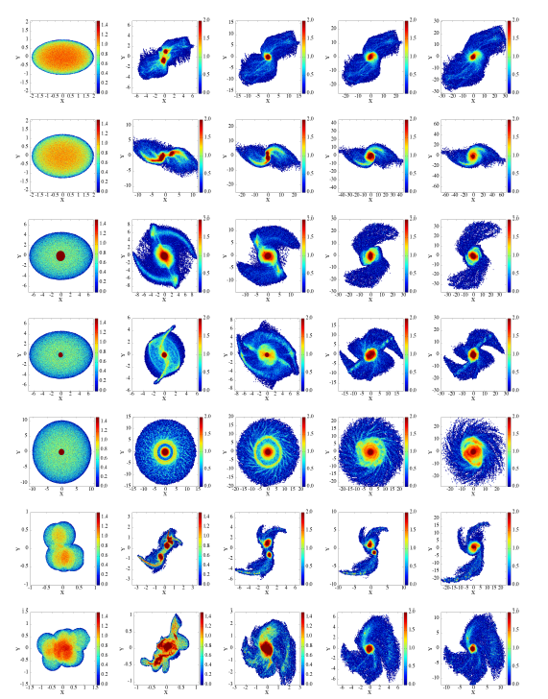

Slide 60
Outline
Long Range Interacting and Self Gravitating Systems
Collapse of an isolated self-gravitating cloud
Formation of a disk and transient arms/bar/rings
Astrophysical considerations
Cosmological considerations
Notes:
v_{200}= \frac{a_3/\tau_d}{200} \;
\mbox{km/sec}
n \approx 50
t_{\rm Gyr} \sim 1
M = \frac{\pi^2 a_3^3}{8 G \tau_d} \approx 10^{11} M_{\odot}
R_1 \approx 2 \;\; \mbox{kpc}
a_3 \approx \left( \frac{200 \, v_{200}}{n}
\times t_{\rm Gyr}\right) \,{\rm kpc}
\[\vec{v}_t = \frac{\vec{r} \times
\vec{v}}{{r}}\;,
\beta (r) = 1 - \frac{\langle v_t^2 \rangle}{2 \langle v_r^2 \rangle}

Slide 61
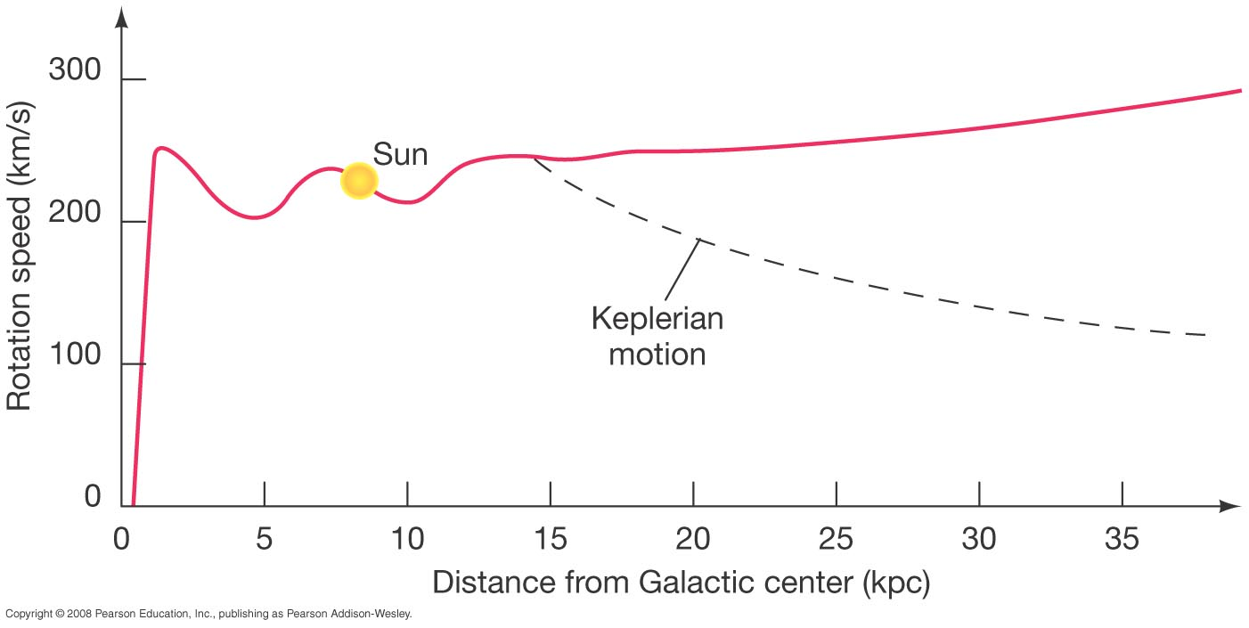

Slide 63
60
30
10

Slide 64
60
30
10

Slide 65
60
30
10

Slide 66
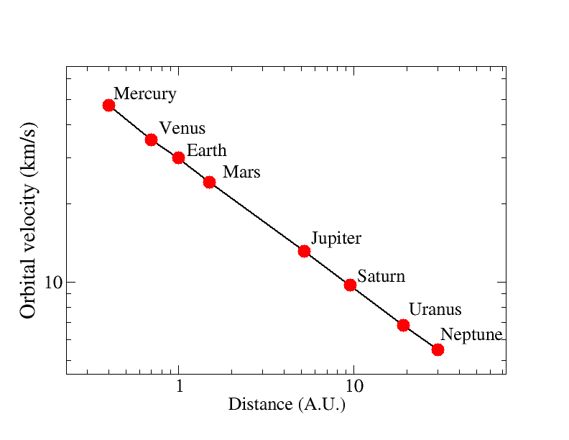
Kepler’s law in the solar system

Slide 67
Kepler’s law in the solar system
250 millions
25 billions
5 billions

Slide 68
z = 0 2 4 6 8 10
T_{H} (Gyr) = 10 3 1.5 1 0.6 0.4
T_{age} ^{(T}_{f}^{=0.4)} (Gyr) = 10 2.6 1.1 0.6 0.2 0
n_{rev}(10kpc,200km/s) = 30 8 3 1 0 0

Slide 69
Stationary equilibrium
Not a trivial assumption!
But used both by DM and MOND
How long to relax ? Transients? Which QSS?
Dynamics of spiral galaxy formation

Slide 70
Stationary equilibrium
Not a trivial assumption!
But used both by DM and MOND
How long to relax ? Transients? Which QSS?
Dynamics of spiral galaxy formation

Slide 71
Stationary equilibrium
Not a trivial assumption!
But used both by DM and MOND
How long to relax ? Transients? Which QSS?
Dynamics of spiral galaxy formation

Slide 72
Stationary equilibrium
Not a trivial assumption!
But used both by DM and MOND
How long to relax ? Transients? Which QSS?
Dynamics of spiral galaxy formation

Slide 73
Stationary equilibrium
Not a trivial assumption!
But used both by DM and MOND
How long to relax ? Transients? Which QSS?
Dynamics of spiral galaxy formation
Gravity is long-range !

Slide 74
Stationary equilibrium
Not a trivial assumption!
But used both by DM and MOND
How long to relax ? Transients? Which QSS?
Dynamics of spiral galaxy formation
Gravity is long-range !

Slide 75

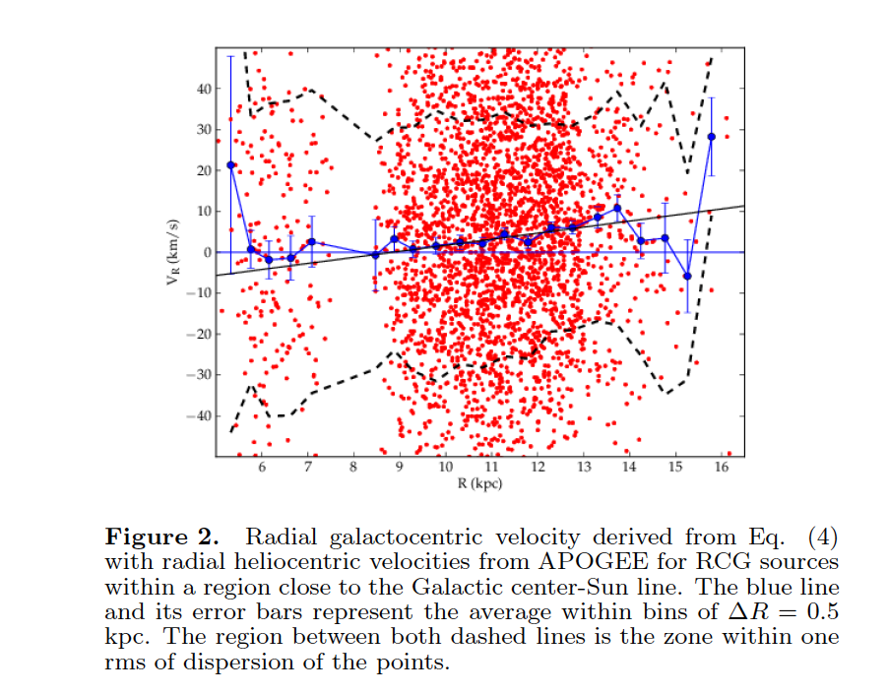
Notes:
In our Galaxy it is possible to map the velocities without such degeneracies in the projection (stars, but mainly for gas)
It is well known that the almost-circular shape of the average orbits should be kept.
A pure radial motion in the orbits is definitively discarded
Possibly there is some component of radial motion apart from circular motion: relatively small radial motions have been measured till ~15 kpc.
Beyond that distance there are very sparse data and we cannot exclude that farther away, beyond 15 kpc, the radial motions are larger or even dominant (very outer disc where DM dominates in the standard interpretation)
Possibly, one could try to get spectra of much more distant stars to clarify the issue. This may also be possible to know when GAIA-DR2 data become available (next year).

Slide 76
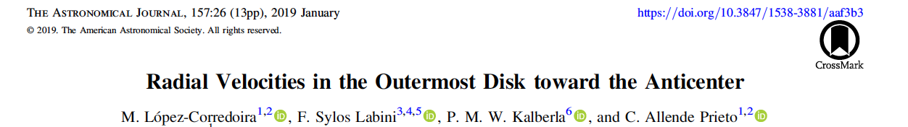
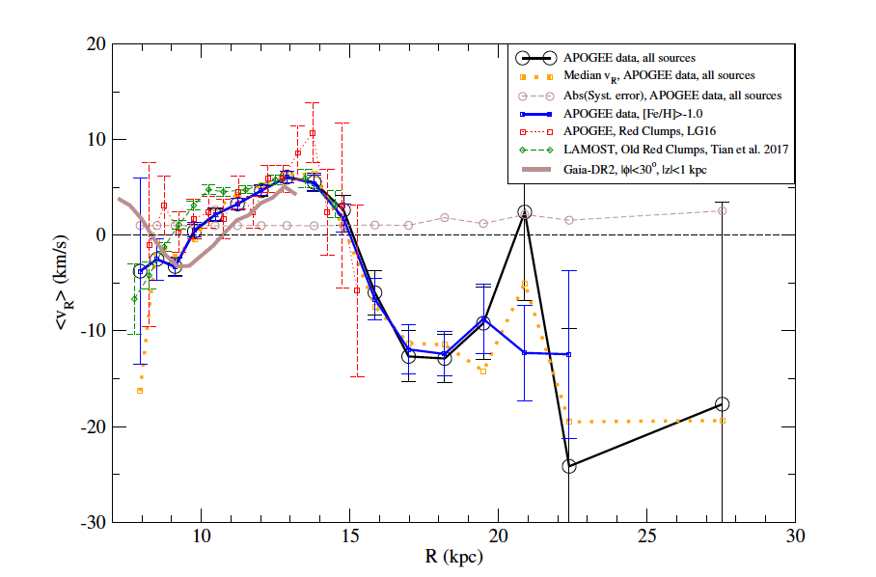

Slide 77
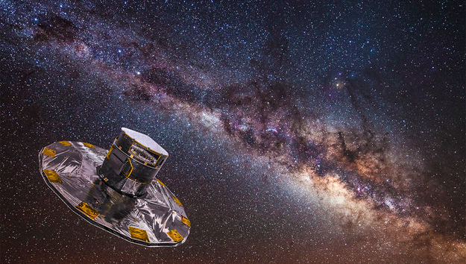

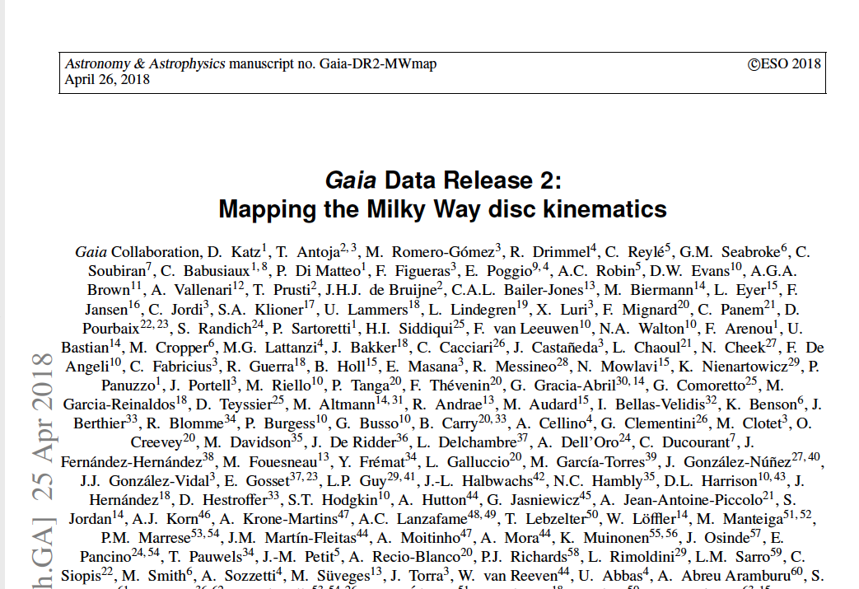

Slide 78
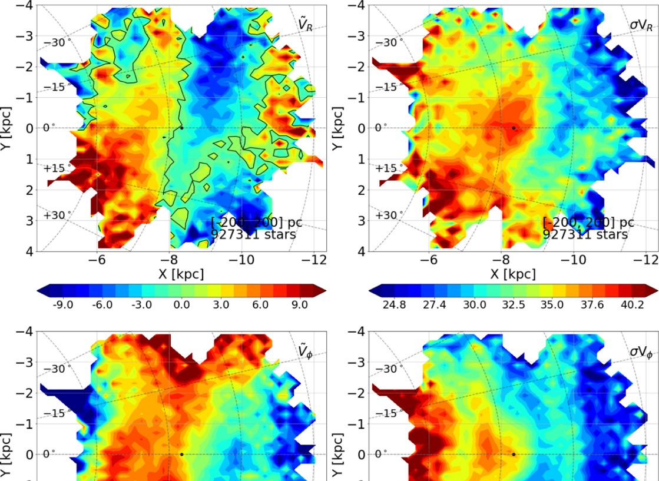
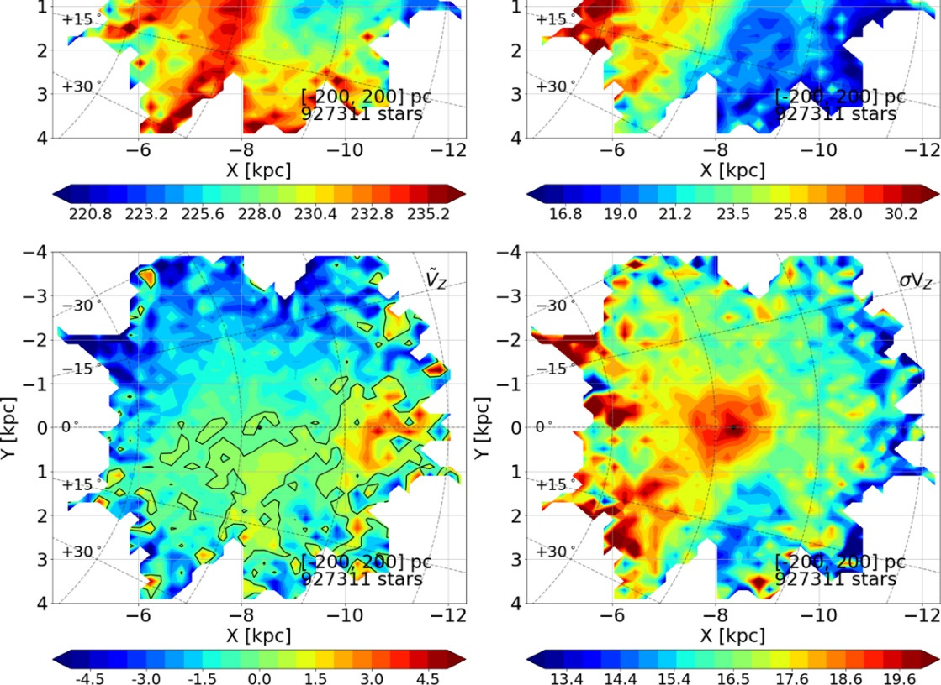

Slide 79
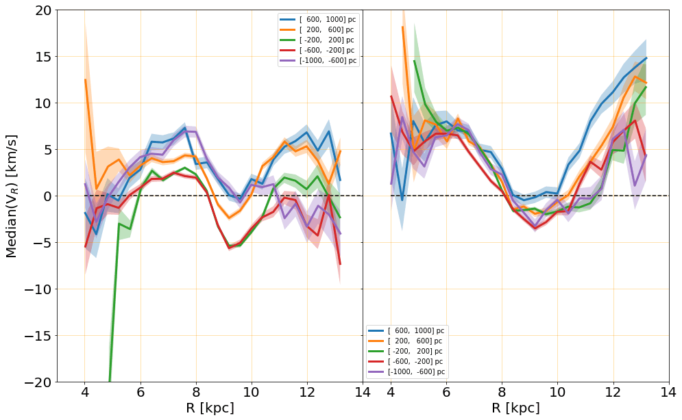

Slide 80
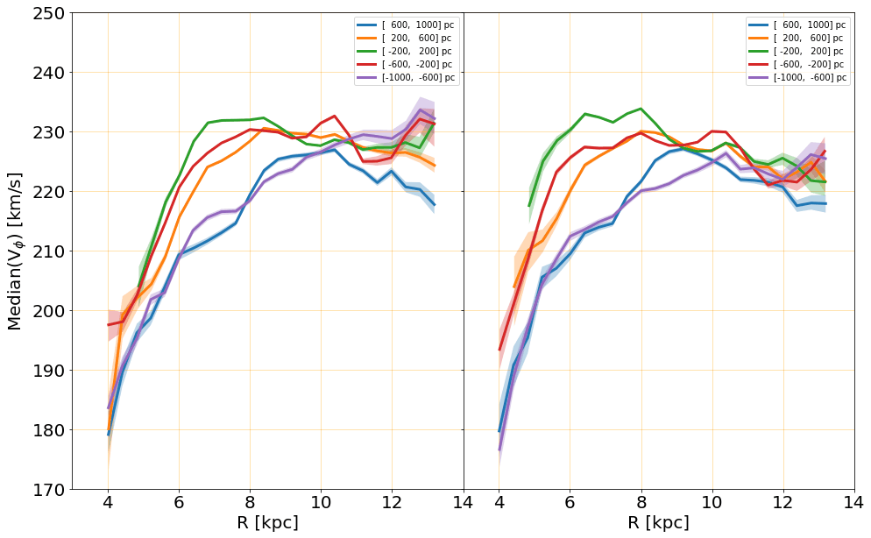

Slide 81
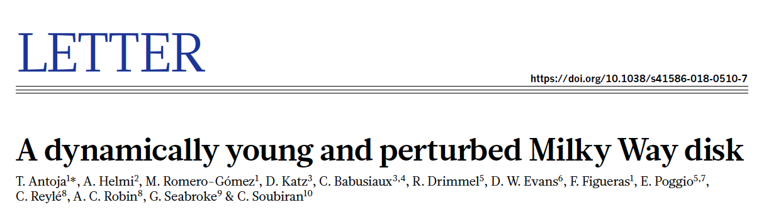
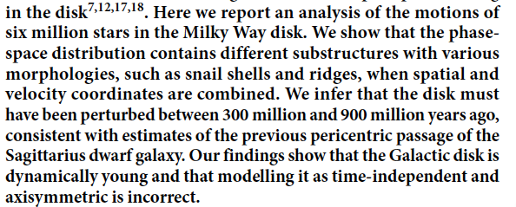
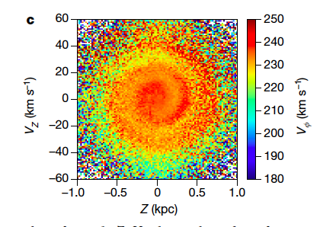

Slide 84


Slide 85



Fredholm integral equation of the first kind

Slide 86

Lucy’s method

Slide 87

Y (kpc)
V_{R} (km/s)
X (kpc)

Slide 88

Y (kpc)
V_{Φ} (km/s)
X (kpc)

Slide 89

Y (kpc)
V_{Z} (km/s)
X (kpc)

Slide 90


Slide 91


Slide 92

Notes:
&& v \sim 200 \times \gamma \;\; \mbox{km/s} \\
&& R \sim 10 \times \alpha \;\; \mbox{kpc} \\
&& v_r \sim 10 \times \delta \;\; \mbox{km/s} \\

Slide 93

Notes:
&& v \sim 200 \times \gamma \;\; \mbox{km/s} \\
&& R \sim 10 \times \alpha \;\; \mbox{kpc} \\
&& v_r \sim 10 \times \delta \;\; \mbox{km/s} \\
\tau_{rev} = \frac{2 \pi R }{v_c} \sim \frac{\alpha}{3 \gamma} \;\; \mbox{Gyr}

Slide 94

Notes:
&& v \sim 200 \times \gamma \;\; \mbox{km/s} \\
&& R \sim 10 \times \alpha \;\; \mbox{kpc} \\
&& v_r \sim 10 \times \delta \;\; \mbox{km/s} \\
\tau_{rev} = \frac{2 \pi R }{v_c} \sim \frac{\alpha}{3 \gamma} \;\; \mbox{Gyr}
\Delta R \sim \tau_{rev} \times v_r \sim 3 \frac{\alpha \times \delta}{ \gamma}

Slide 95

Notes:
&& v \sim 200 \times \gamma \;\; \mbox{km/s} \\
&& R \sim 10 \times \alpha \;\; \mbox{kpc} \\
&& v_r \sim 10 \times \delta \;\; \mbox{km/s} \\
\tau_{rev} = \frac{2 \pi R }{v_c} \sim \frac{\alpha}{3 \gamma} \;\; \mbox{Gyr}
\Delta R \sim \tau_{rev} \times v_r \sim 3 \frac{\alpha \times \delta}{ \gamma}
\frac{ \Delta R } {R} \sim \frac{\delta}{ 3 \gamma}

Slide 96

Notes:
&& v_c \sim 200 \times \gamma \;\; \mbox{km/s} \\
&& R \sim 10 \times \alpha \;\; \mbox{kpc} \\
&& v_r \sim 10 \times \delta \;\; \mbox{km/s} \\
\tau_{rev} = \frac{2 \pi R }{v_c} \sim \frac{\alpha}{3 \gamma} \;\; \mbox{Gyr}
\Delta R \sim \tau_{rev} \times v_r \sim 3 \frac{\alpha \times \delta}{ \gamma}
\frac{ \Delta R } {R} \sim \frac{\delta}{ 3 \gamma}
\gamma=\delta=1 \rightarrow
\frac{v_c}{v_r} \approx 20 \rightarrow \frac{ \Delta R } {R} \sim \frac{1}{ 3}

Slide 97

Notes:
v_{200}= \frac{a_3/\tau_d}{200} \;
\mbox{km/sec}
n \approx 50
t_{\rm Gyr} \sim 1
M = \frac{\pi^2 a_3^3}{8 G \tau_d} \approx 10^{11} M_{\odot}
R_1 \approx 2 \;\; \mbox{kpc}
a_3 \approx \left( \frac{200 \, v_{200}}{n}
\times t_{\rm Gyr}\right) \,{\rm kpc}
\[\vec{v}_t = \frac{\vec{r} \times
\vec{v}}{{r}}\;,
\beta (r) = 1 - \frac{\langle v_t^2 \rangle}{2 \langle v_r^2 \rangle}

Slide 100


Slide 101


Slide 102


Slide 103

Notes:
v_{200}= \frac{a_3/\tau_d}{200} \;
\mbox{km/sec}
n \approx 50
t_{\rm Gyr} \sim 1
M = \frac{\pi^2 a_3^3}{8 G \tau_d} \approx 10^{11} M_{\odot}
R_1 \approx 2 \;\; \mbox{kpc}
a_3 \approx \left( \frac{200 \, v_{200}}{n}
\times t_{\rm Gyr}\right) \,{\rm kpc}
\[\vec{v}_t = \frac{\vec{r} \times
\vec{v}}{{r}}\;,
\beta (r) = 1 - \frac{\langle v_t^2 \rangle}{2 \langle v_r^2 \rangle}

Slide 104
Outline
Long Range Interacting and Self Gravitating Systems
Collapse of an isolated self-gravitating cloud
Formation of a disk and transient arms/bar/rings
Astrophysical considerations
Cosmological considerations
Notes:
v_{200}= \frac{a_3/\tau_d}{200} \;
\mbox{km/sec}
n \approx 50
t_{\rm Gyr} \sim 1
M = \frac{\pi^2 a_3^3}{8 G \tau_d} \approx 10^{11} M_{\odot}
R_1 \approx 2 \;\; \mbox{kpc}
a_3 \approx \left( \frac{200 \, v_{200}}{n}
\times t_{\rm Gyr}\right) \,{\rm kpc}
\[\vec{v}_t = \frac{\vec{r} \times
\vec{v}}{{r}}\;,
\beta (r) = 1 - \frac{\langle v_t^2 \rangle}{2 \langle v_r^2 \rangle}

Slide 105

CDM

Slide 106

Time

Slide 107

Time

Slide 108





Slide 109

Gas Stars SelfGravitating

Slide 110
Small scales !
CDM

Slide 111

Time

Slide 112
Conclusions
New behaviour of systems with long range interactions
Notes:
v_{200}= \frac{a_3/\tau_d}{200} \;
\mbox{km/sec}
n \approx 50
t_{\rm Gyr} \sim 1
M = \frac{\pi^2 a_3^3}{8 G \tau_d} \approx 10^{11} M_{\odot}
R_1 \approx 2 \;\; \mbox{kpc}
a_3 \approx \left( \frac{200 \, v_{200}}{n}
\times t_{\rm Gyr}\right) \,{\rm kpc}
\[\vec{v}_t = \frac{\vec{r} \times
\vec{v}}{{r}}\;,
\beta (r) = 1 - \frac{\langle v_t^2 \rangle}{2 \langle v_r^2 \rangle}

Slide 113
Conclusions
New behaviour of systems with long range interactions
New dynamical mechanism for the formation of a disk and spiral arms (+ bar, rings…)
Notes:
v_{200}= \frac{a_3/\tau_d}{200} \;
\mbox{km/sec}
n \approx 50
t_{\rm Gyr} \sim 1
M = \frac{\pi^2 a_3^3}{8 G \tau_d} \approx 10^{11} M_{\odot}
R_1 \approx 2 \;\; \mbox{kpc}
a_3 \approx \left( \frac{200 \, v_{200}}{n}
\times t_{\rm Gyr}\right) \,{\rm kpc}
\[\vec{v}_t = \frac{\vec{r} \times
\vec{v}}{{r}}\;,
\beta (r) = 1 - \frac{\langle v_t^2 \rangle}{2 \langle v_r^2 \rangle}

Slide 114
Conclusions
New behaviour of systems with long range interactions
New dynamical mechanism for the formation of a disk and spiral arms (+ bar, rings…)
Interpretation of the velocity maps of external galaxies
Notes:
v_{200}= \frac{a_3/\tau_d}{200} \;
\mbox{km/sec}
n \approx 50
t_{\rm Gyr} \sim 1
M = \frac{\pi^2 a_3^3}{8 G \tau_d} \approx 10^{11} M_{\odot}
R_1 \approx 2 \;\; \mbox{kpc}
a_3 \approx \left( \frac{200 \, v_{200}}{n}
\times t_{\rm Gyr}\right) \,{\rm kpc}
\[\vec{v}_t = \frac{\vec{r} \times
\vec{v}}{{r}}\;,
\beta (r) = 1 - \frac{\langle v_t^2 \rangle}{2 \langle v_r^2 \rangle}

Slide 115
Conclusions
New behaviour of systems with long range interactions
New dynamical mechanism for the formation of a disk and spiral arms (+ bar, rings…)
Interpretation of the velocity maps of external galaxies
Qualitative predictions for the velocity fields in our Galaxy
Notes:
v_{200}= \frac{a_3/\tau_d}{200} \;
\mbox{km/sec}
n \approx 50
t_{\rm Gyr} \sim 1
M = \frac{\pi^2 a_3^3}{8 G \tau_d} \approx 10^{11} M_{\odot}
R_1 \approx 2 \;\; \mbox{kpc}
a_3 \approx \left( \frac{200 \, v_{200}}{n}
\times t_{\rm Gyr}\right) \,{\rm kpc}
\[\vec{v}_t = \frac{\vec{r} \times
\vec{v}}{{r}}\;,
\beta (r) = 1 - \frac{\langle v_t^2 \rangle}{2 \langle v_r^2 \rangle}

Slide 116



HPC resources of The Institute for scientific Computing and Simulation financed by Region Ile de France and the project
Equip@Meso
https://francescosyloslabini.info/
https://www.isc.cnr.it/groups/transgrav/

